Slide 1


Various methods for
Environmental data handling
(Statistical Model,
Statistical Machine Learning Algorithm)
국립환경과학원 영산강물환경연구소
연구사 황성윤

Slide 2
contents
01
Introduction
02
Statistical Models
03
Statistical Machine Learning Algorithms
Notes:
.

Slide 3
01
Introduction

Slide 4

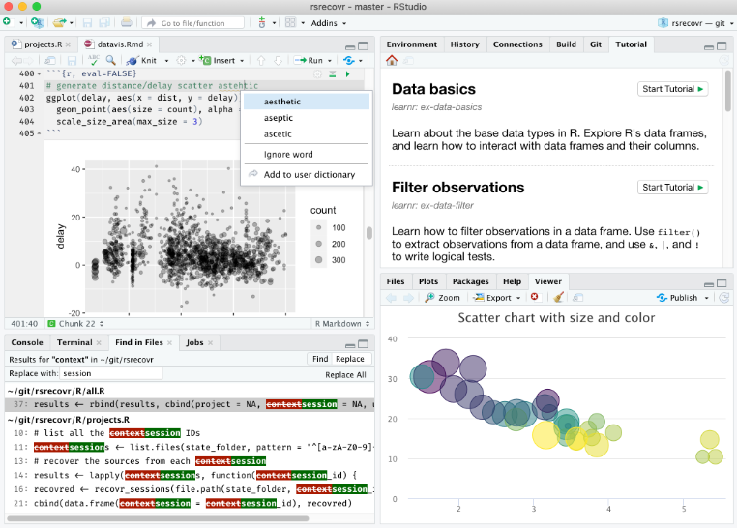
1. Introduction
1. R
(1) 통계 계산과 그래픽을 위한 프로그래밍 언어이자 소프트웨어 환경
(2) 1960년대와 1970년대 Bell 연구소에서 개발된 S language에 기반을 두고, 1990년대 중반 뉴질랜드 오클랜드 대학의 로스 이하카와 로버트 젠틀맨에 의해 시작
(3) GPL 하에 배포되는 공개 소프트웨어로 누구나 자유롭게 이용할 수 있으며 자발적 기여자들에 의해 지속적으로 개발 중임
(4) 대표적 특징
1) 효율적이고 편리한 데이터 조작 및 처리
2) 데이터를 다양한 그래프로 표현해주는 데이터 시각화 기능
3) 통계 분석 및 데이터 마이닝 알고리즘 수행
4) 간단하며 효과적인 프로그래밍 언어로서의 기능

Slide 5
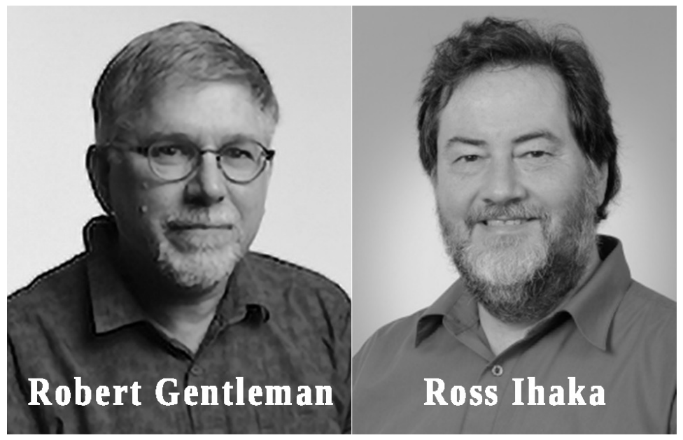
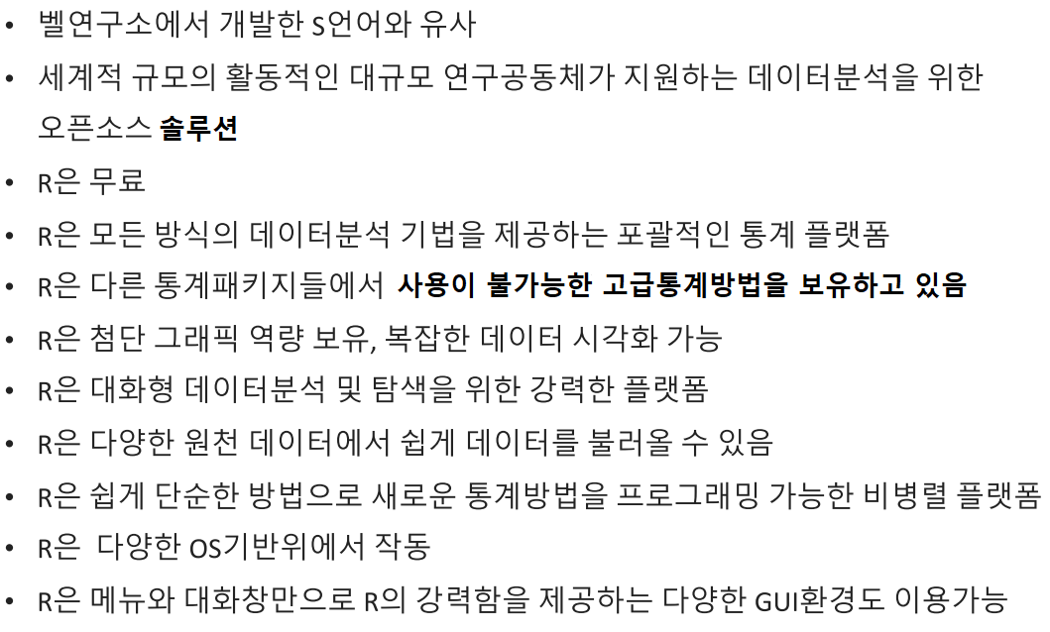
1. Introduction
1. R

Slide 6
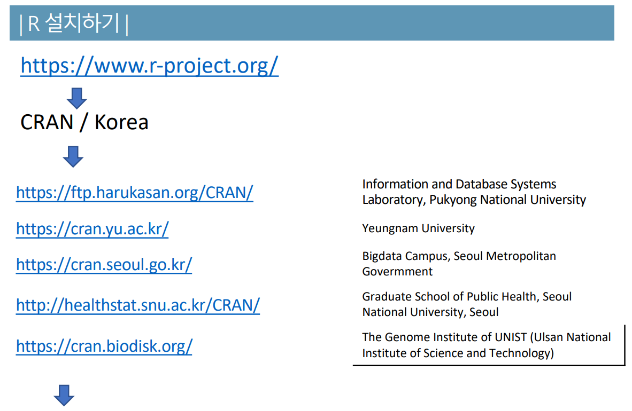
1. Introduction
1. R

Slide 7
1. Introduction
1. R

Slide 8
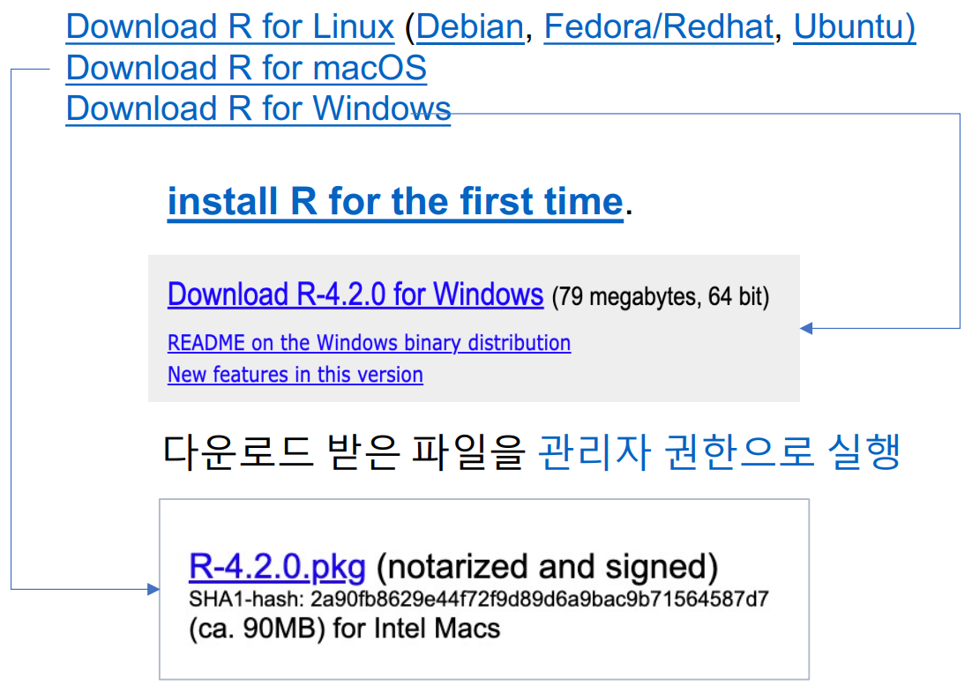
1. Introduction
1. R

Slide 9
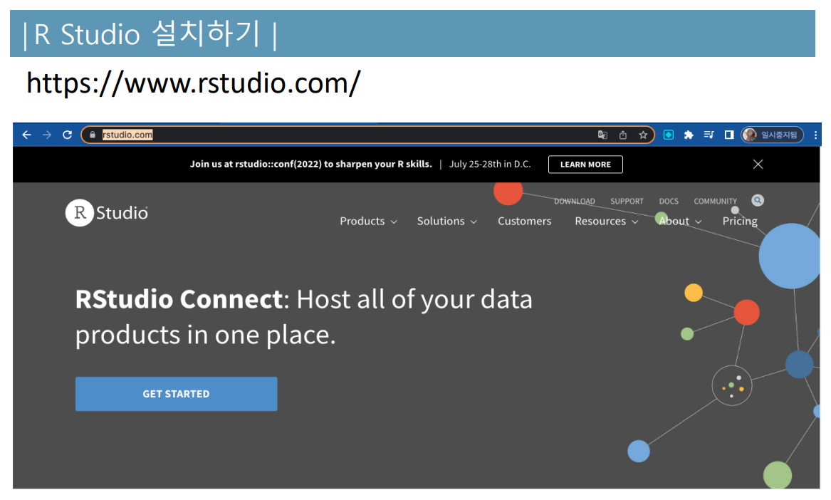
1. Introduction
1. R

Slide 10
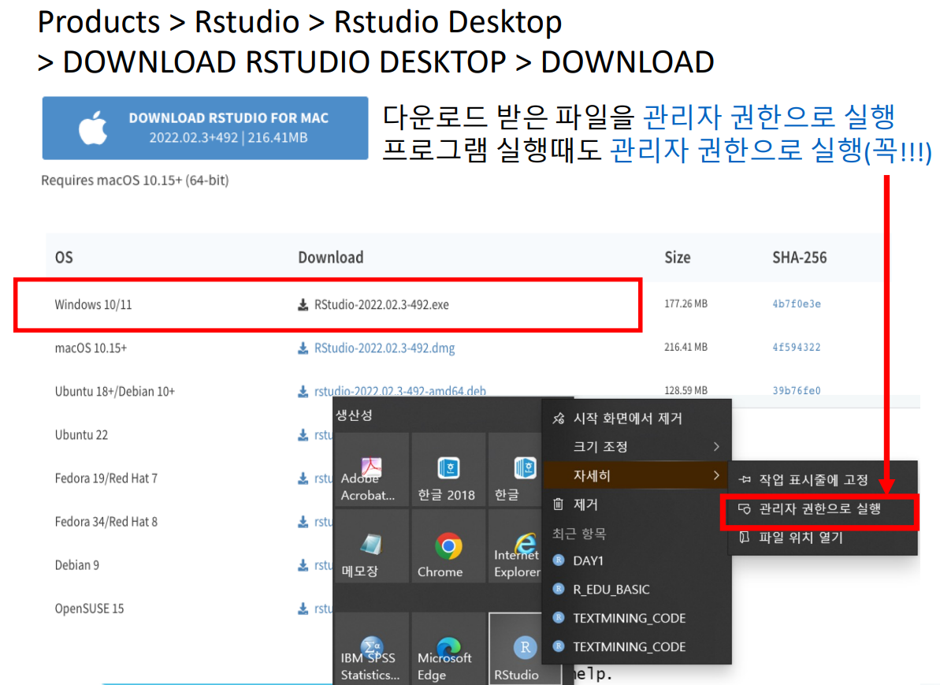
1. Introduction
1. R

Slide 11
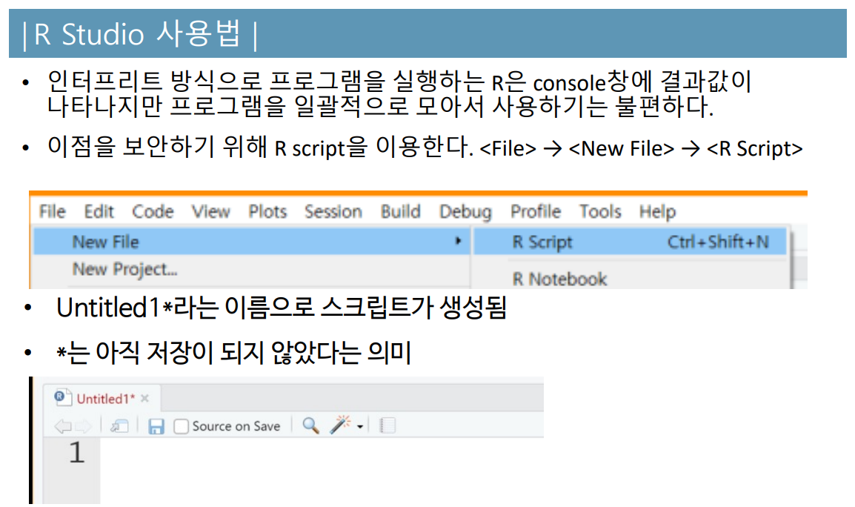
1. Introduction
1. R

Slide 12
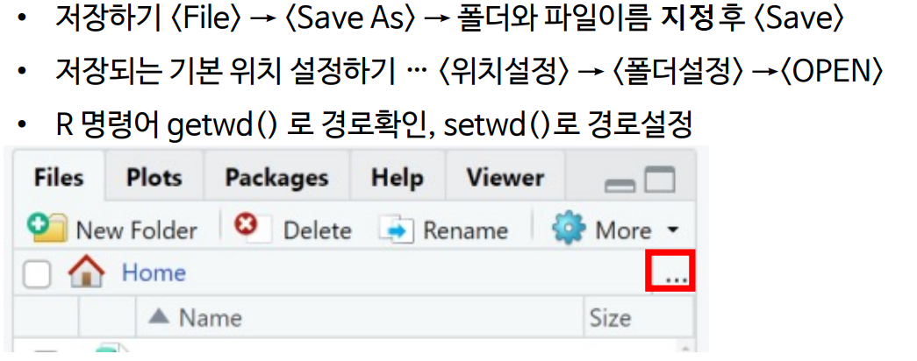
1. Introduction
1. R

Slide 13
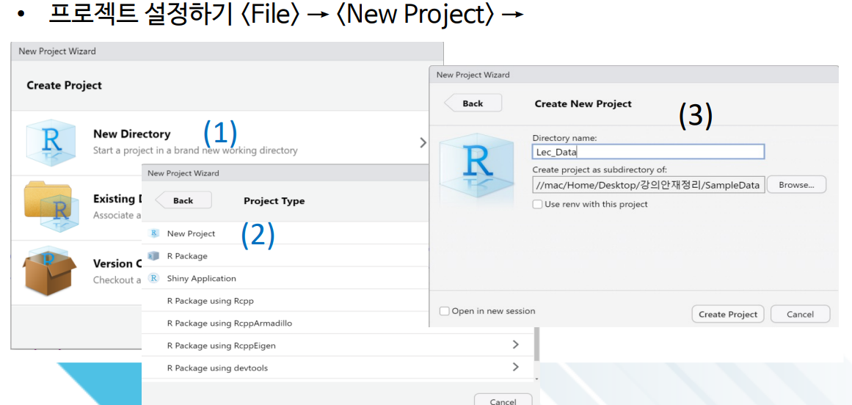
1. Introduction
1. R

Slide 14
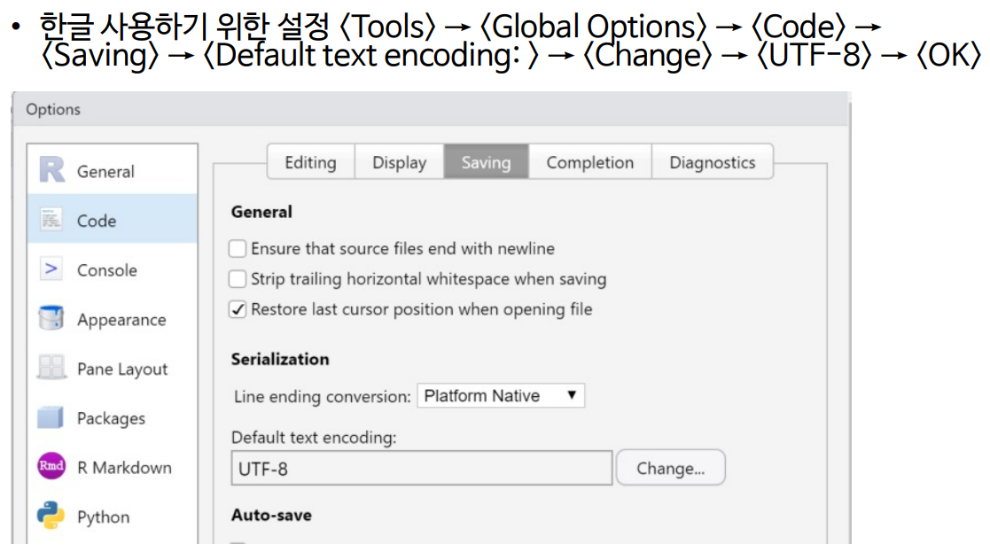
1. Introduction
1. R

Slide 15
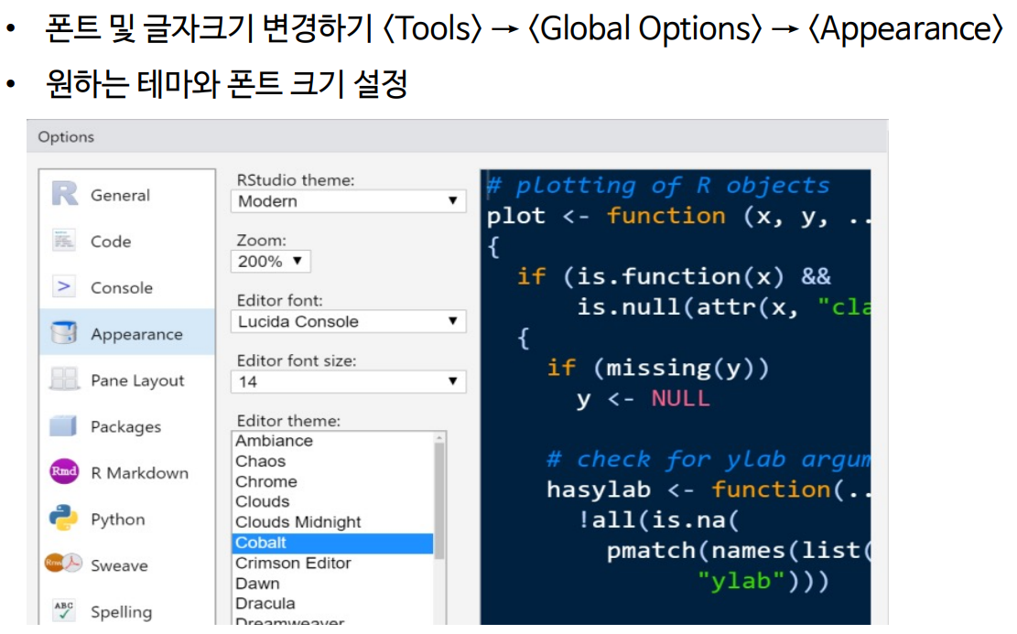
1. Introduction
1. R

Slide 16
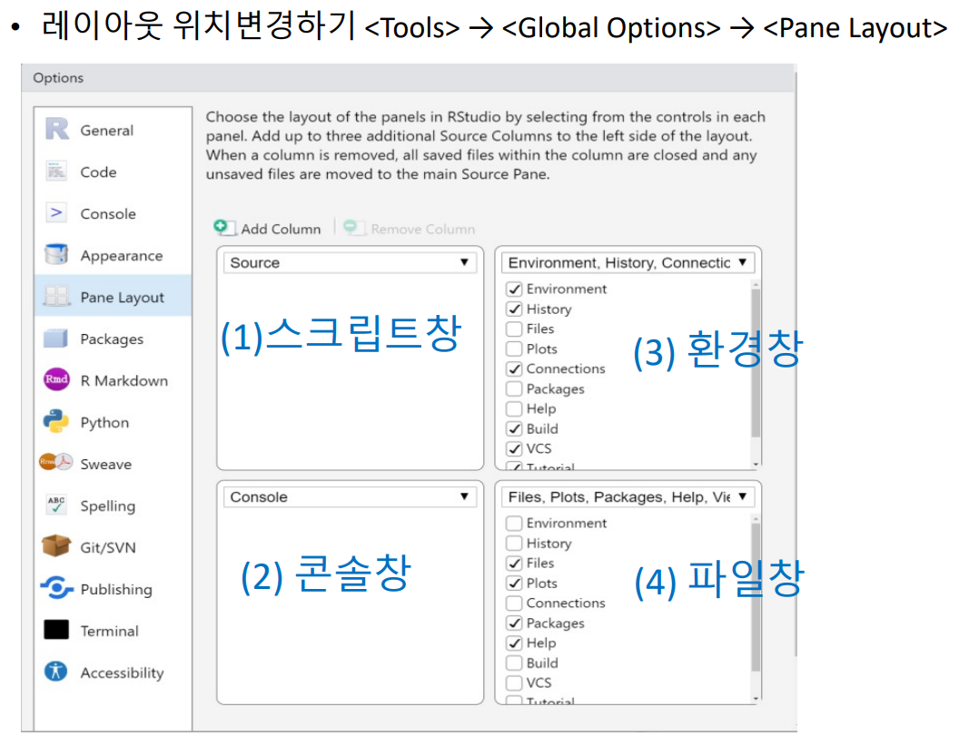
1. Introduction
1. R

Slide 17
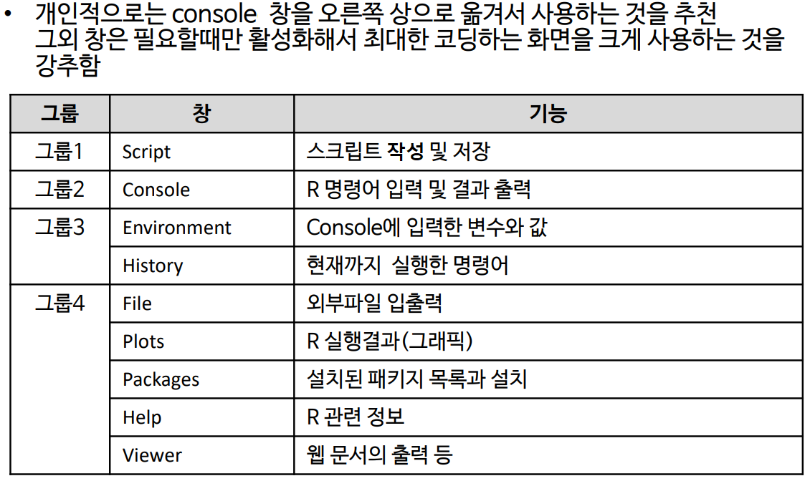
1. Introduction
1. R

Slide 18


1. Introduction
2. Python
(1) 1991년 네덜란드계 소프트웨어 엔지니어인 귀도 반 로섬에 의해 개발된 고급 프로그래밍 언어
(2) 플랫폼에 독립적이며 객체 지향적, 동적 타이핑 대화형 언어
(3) 강력한 라이브러리와 풍부한 생태계를 통해, 데이터를 수집하고 분석하며 시각화할 수 있음
(4) 대표적 특징
1) 문법이 쉬워 빠르게 배울 수 있음
2) 무료이지만 강력한 데이터 처리기능 보유
3) 간결한 형식의 코딩
4) 개발 속도가 빠르며 인공지능 기반 model에 특화되어 있음

Slide 19
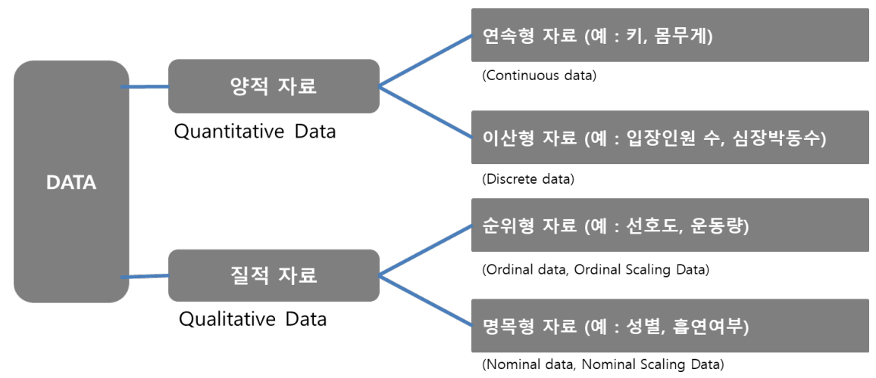
1. Introduction
3. Type of Data

Slide 20
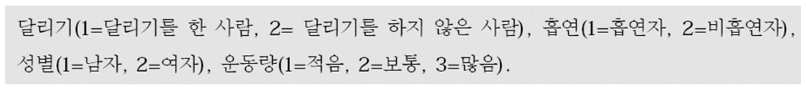
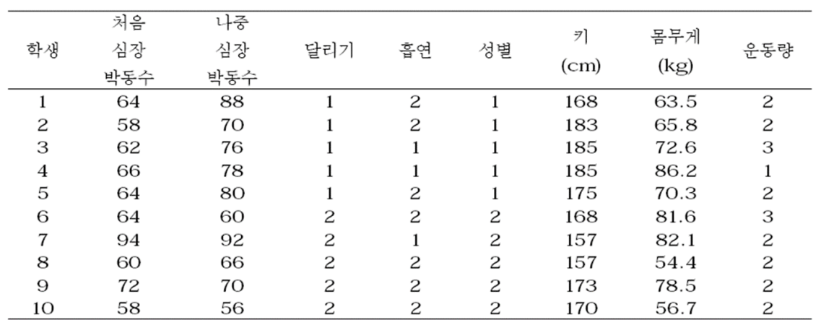
1. Introduction
3. Type of Data

Slide 21
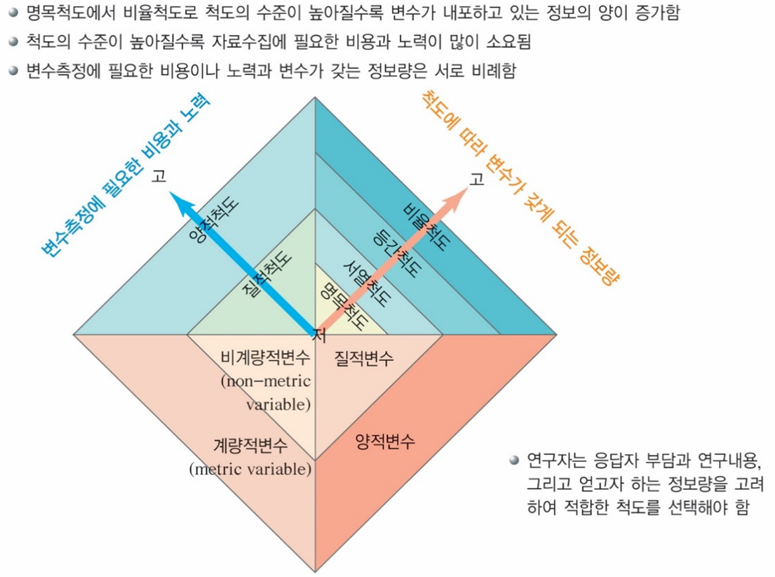
1. Introduction
3. Type of Data

Slide 22
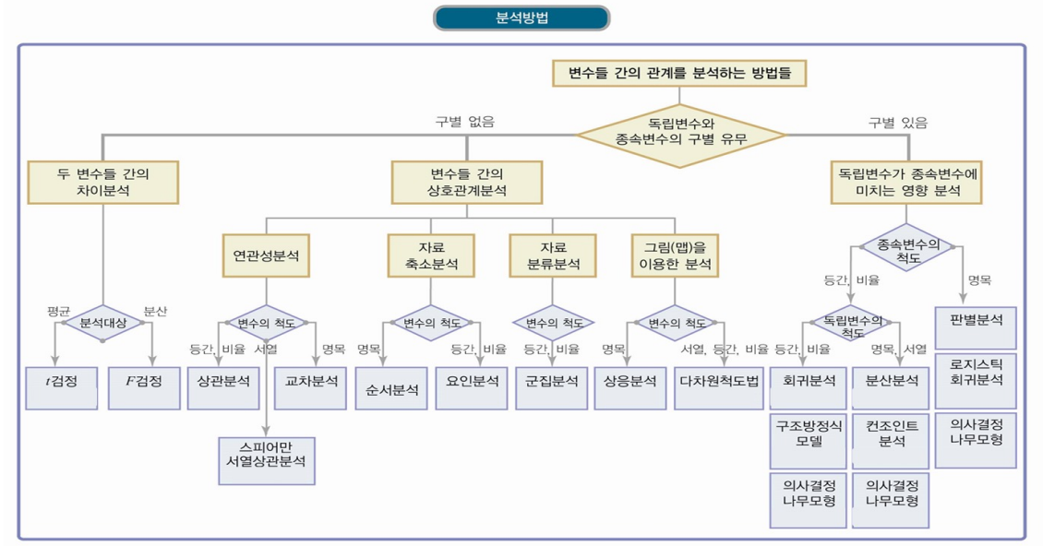
1. Introduction
3. Type of Data

Slide 23
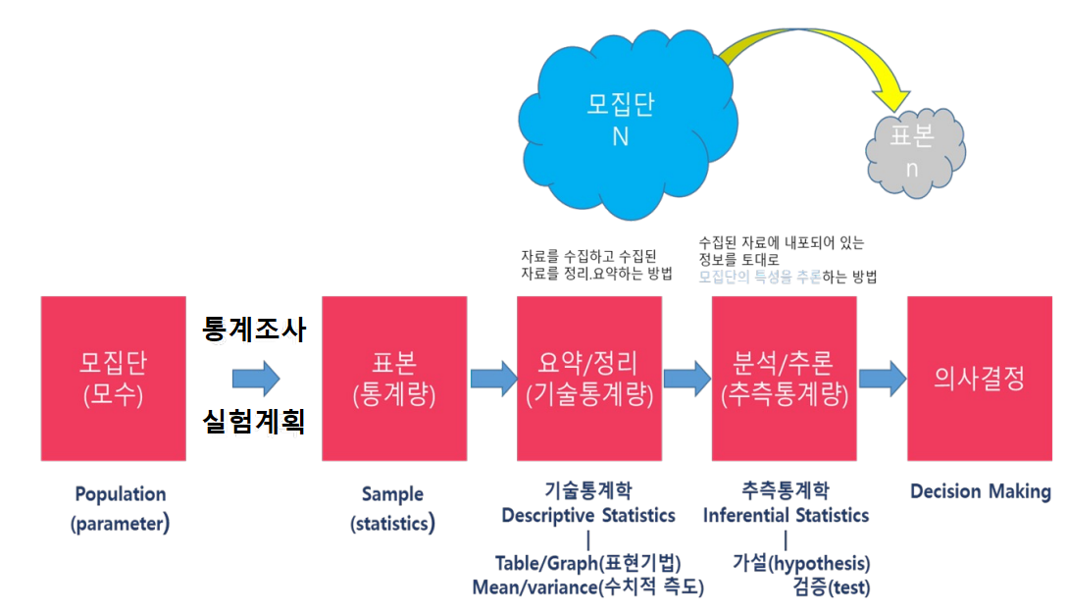
1. Introduction
3. Type of Data
출처 : Statistics Analysis Using R (Application Course) 2022 / R을 이용한 환경데이터 분석-응용과정

Slide 24
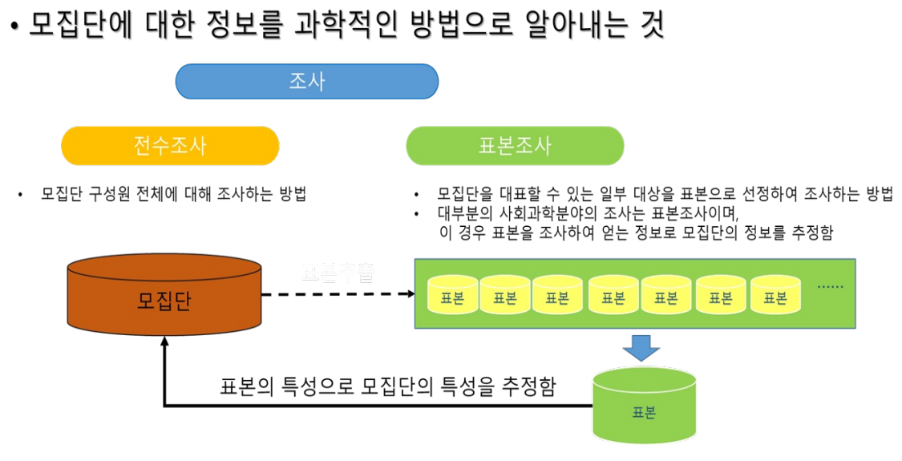
1. Introduction
4. Statistical Survey
출처 : Statistics Analysis Using R (Application Course) 2022 / R을 이용한 환경데이터 분석-응용과정

Slide 25
02
Statistical Models

Slide 26
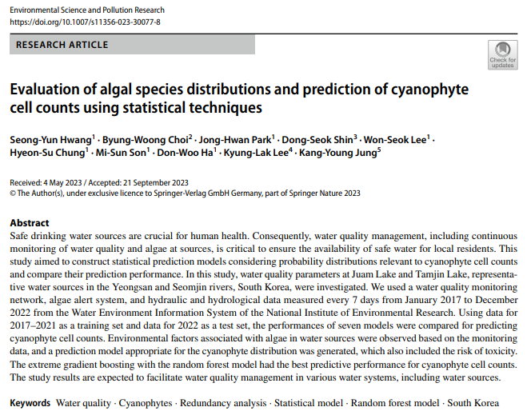
2. Statistical Models
Evaluation of algal species distributions and prediction of cyanophyte cell counts using statistical techniques

Slide 27
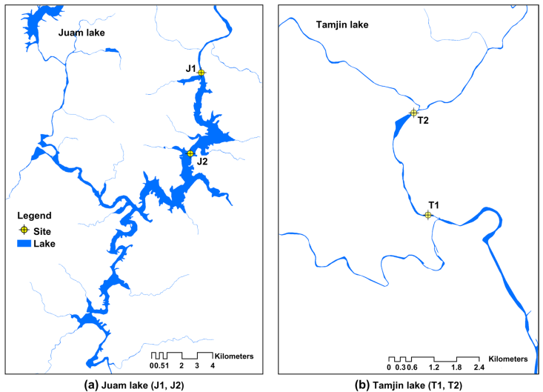
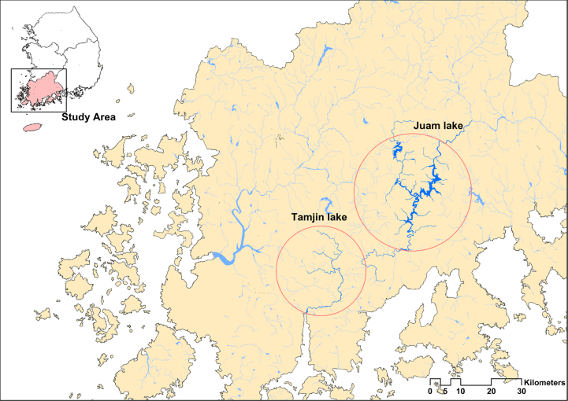
2. Statistical Models
Evaluation of algal species distributions and prediction of cyanophyte cell counts using statistical techniques

Slide 28
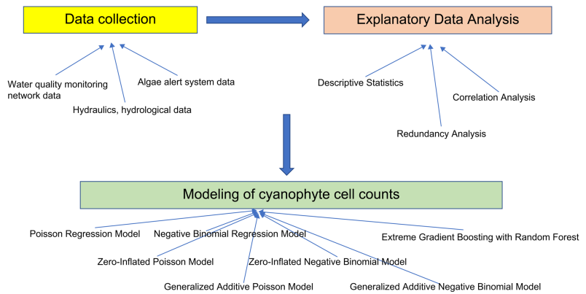
2. Statistical Models
Evaluation of algal species distributions and prediction of cyanophyte cell counts using statistical techniques

Slide 29
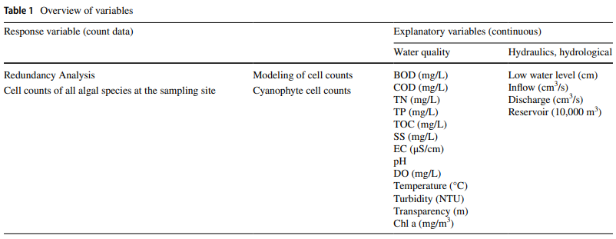
2. Statistical Models
Evaluation of algal species distributions and prediction of cyanophyte cell counts using statistical techniques

Slide 30
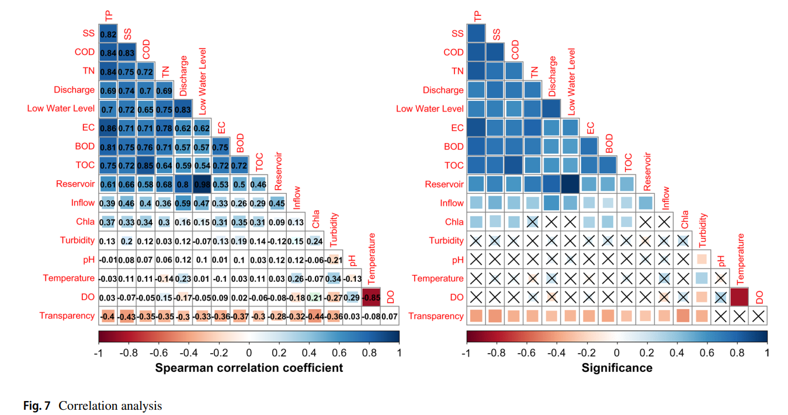
2. Statistical Models
Evaluation of algal species distributions and prediction of cyanophyte cell counts using statistical techniques

Slide 31
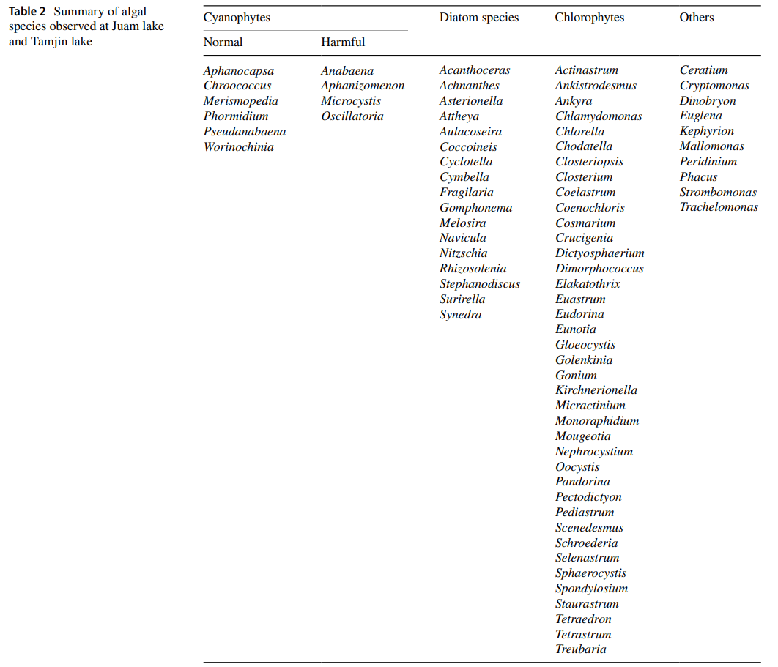
2. Statistical Models
Evaluation of algal species distributions and prediction of cyanophyte cell counts using statistical techniques

Slide 32
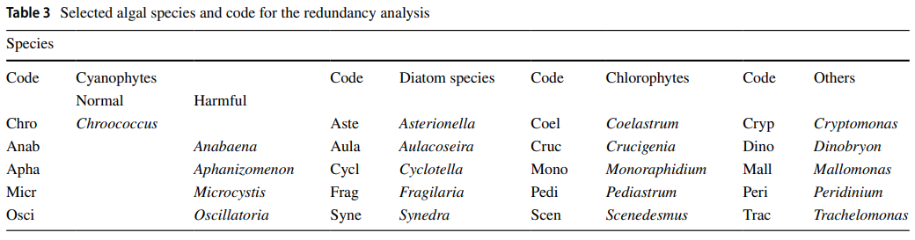
2. Statistical Models
Evaluation of algal species distributions and prediction of cyanophyte cell counts using statistical techniques

Slide 33
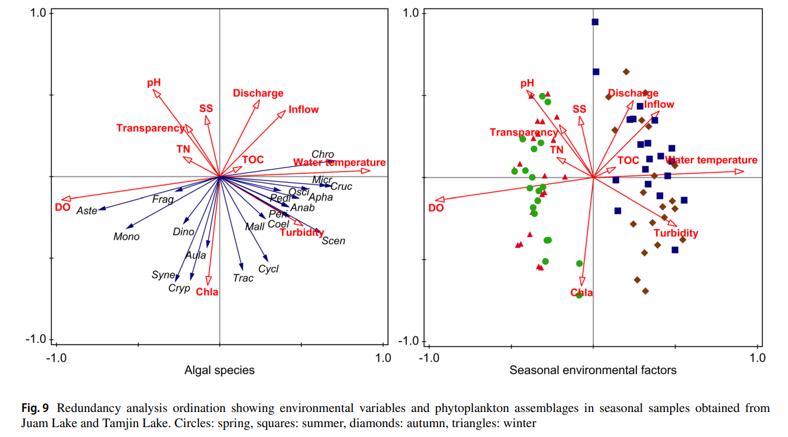
2. Statistical Models
Evaluation of algal species distributions and prediction of cyanophyte cell counts using statistical techniques

Slide 34
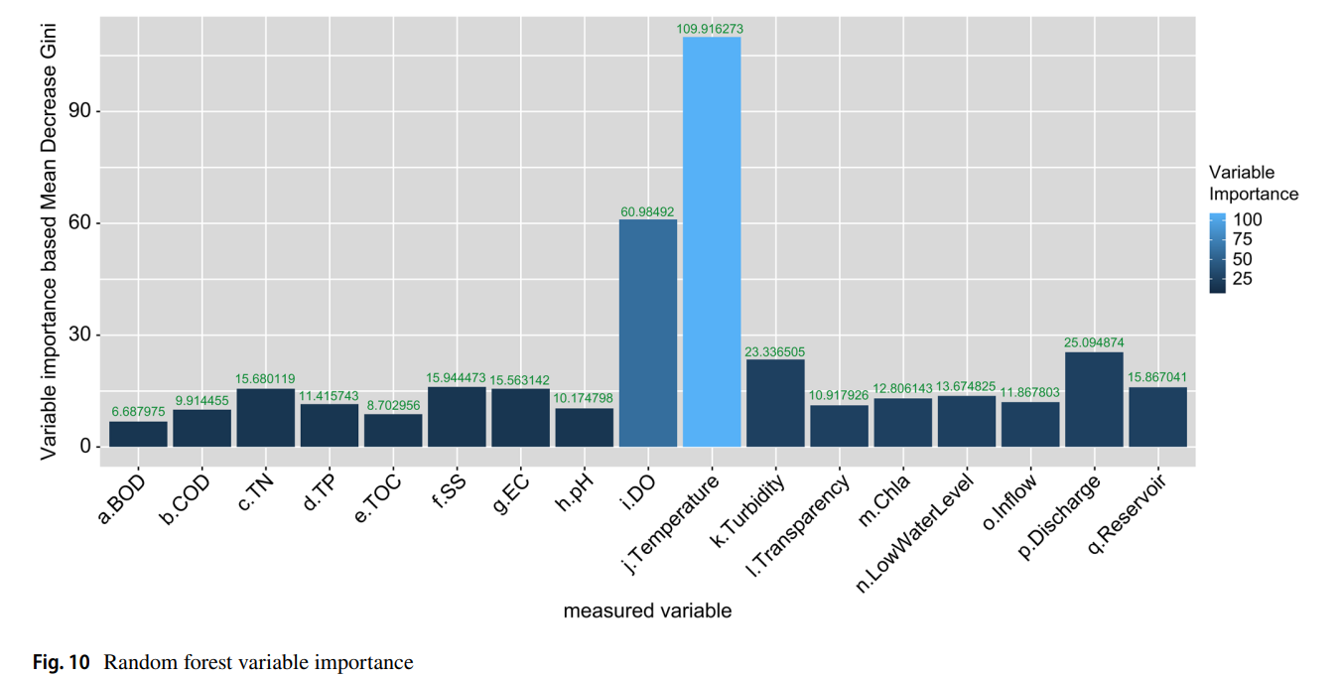
2. Statistical Models
Evaluation of algal species distributions and prediction of cyanophyte cell counts using statistical techniques

Slide 35
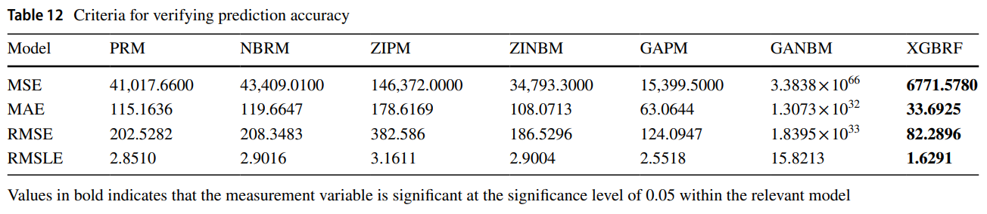
2. Statistical Models
Evaluation of algal species distributions and prediction of cyanophyte cell counts using statistical techniques

Slide 36
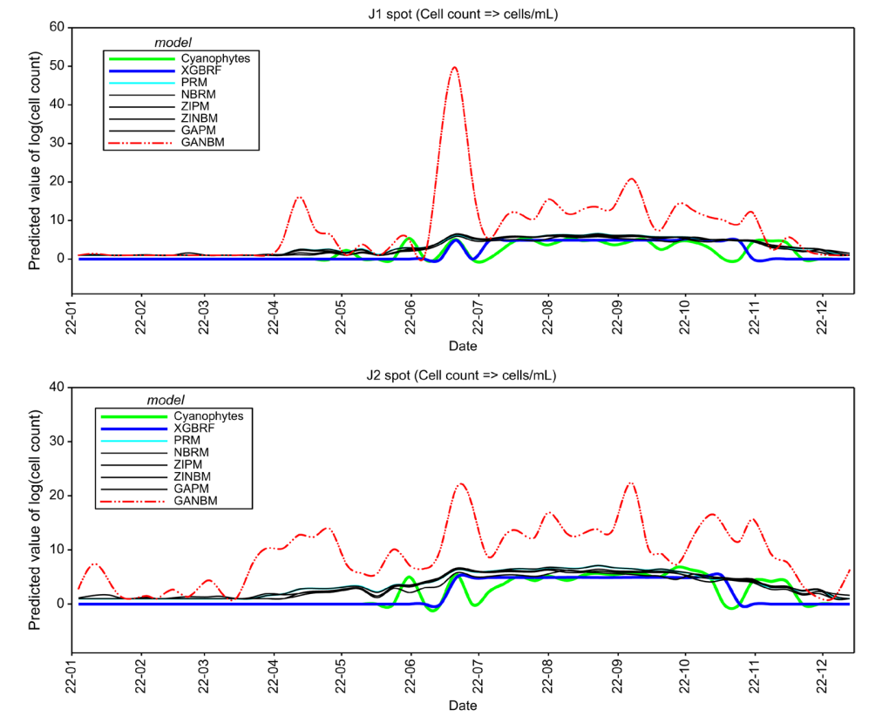
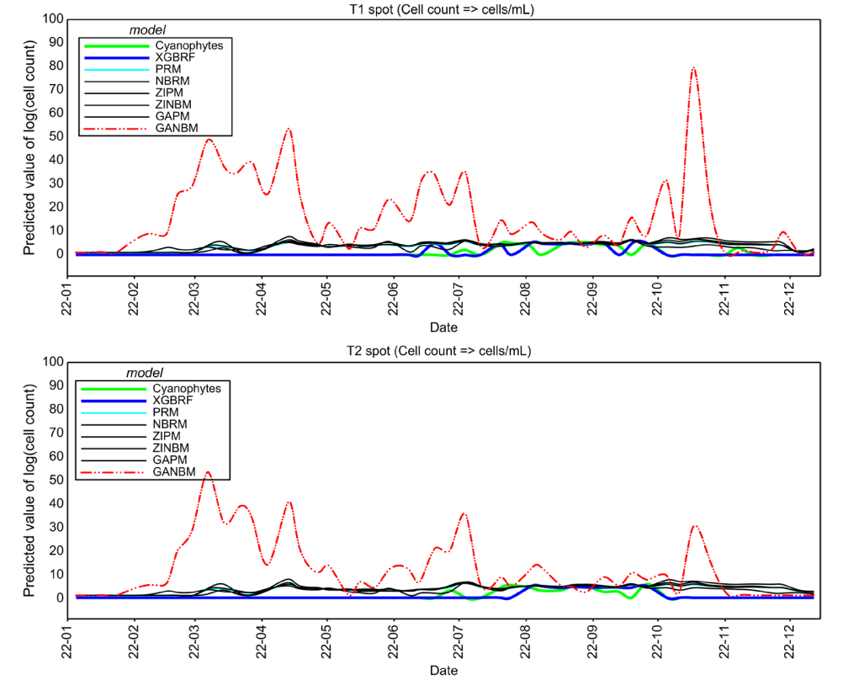
2. Statistical Models
Evaluation of algal species distributions and prediction of cyanophyte cell counts using statistical techniques

Slide 37
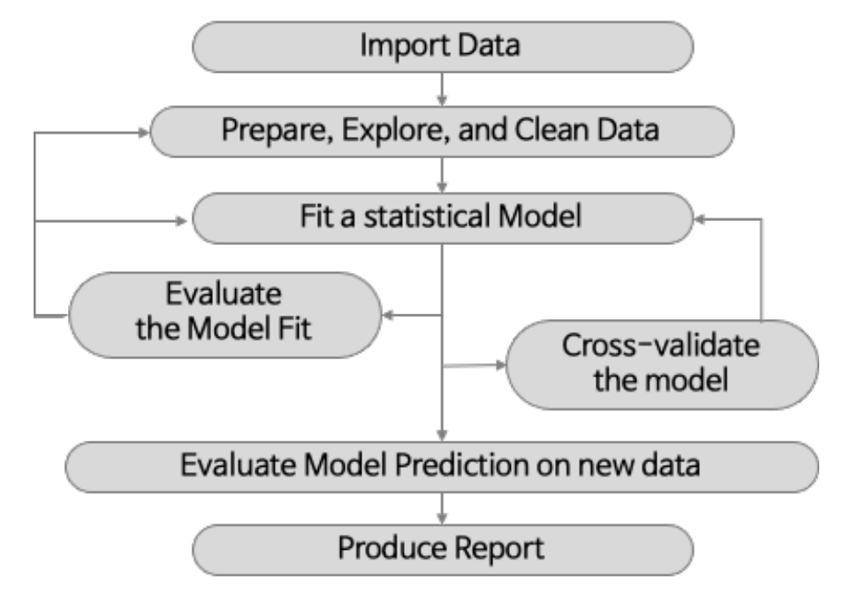
2. Statistical Models
2. Various statistical models
출처: 빅데이터 분석도구 R in Action

Slide 38
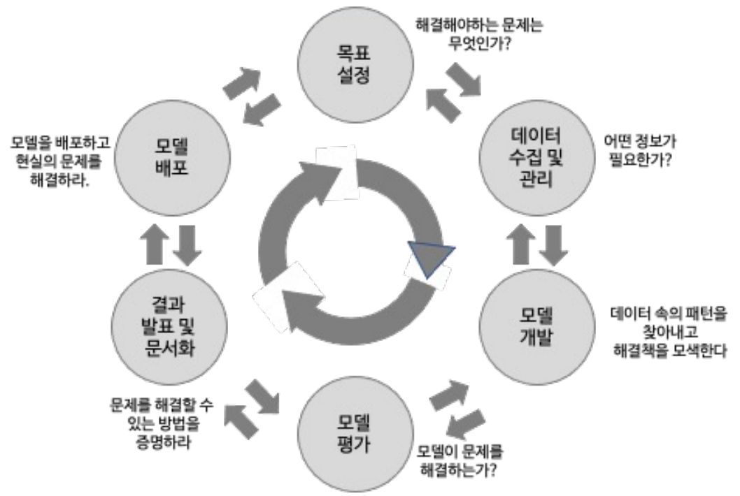
2. Statistical Models
2. Various statistical models
출처: Practical Data Science with R

Slide 39
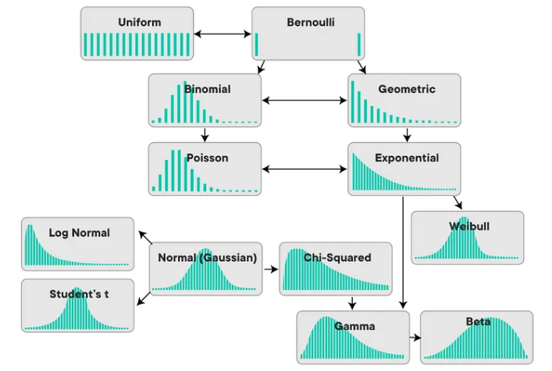
2. Statistical Models
2. Various statistical models
Probability Distributions
Statistical Models
RIDGE model
Multiple Regression Model
LASSO model
Generalized Linear Model
Elastic-Net Model
Logistic
Poisson
Generalized Additive Model
Time-Varying Coefficient Model

Slide 40
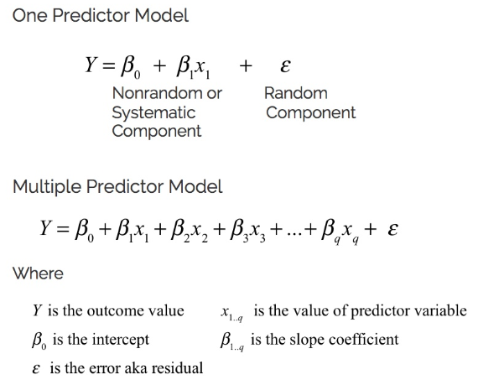
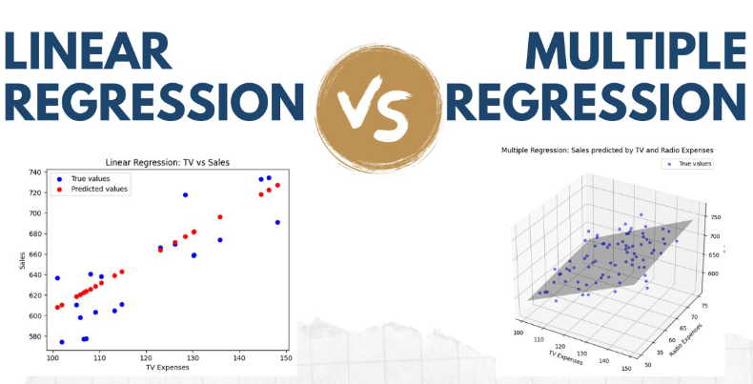
2. Statistical Models
2. Various statistical models
1) Multiple Regression Model

Slide 41
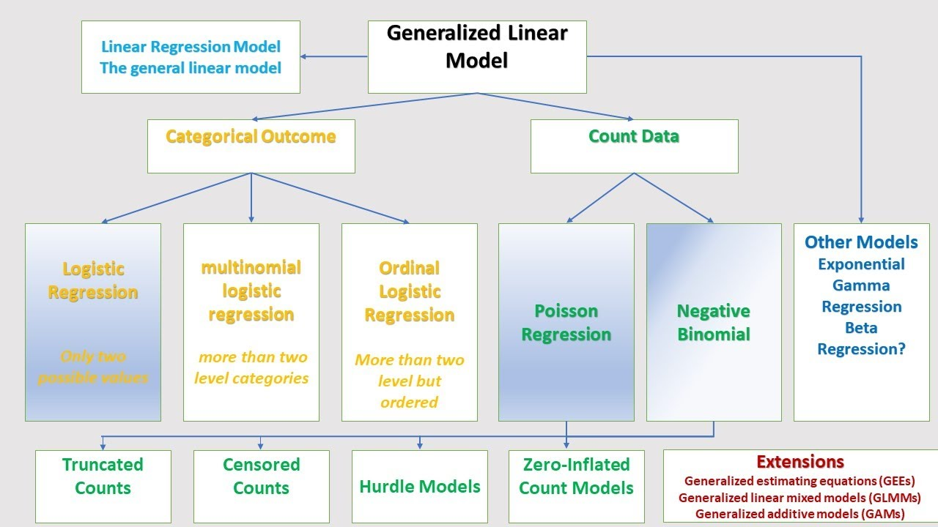
2. Statistical Models
2. Various statistical models
2) Generalized Linear Model

Slide 42
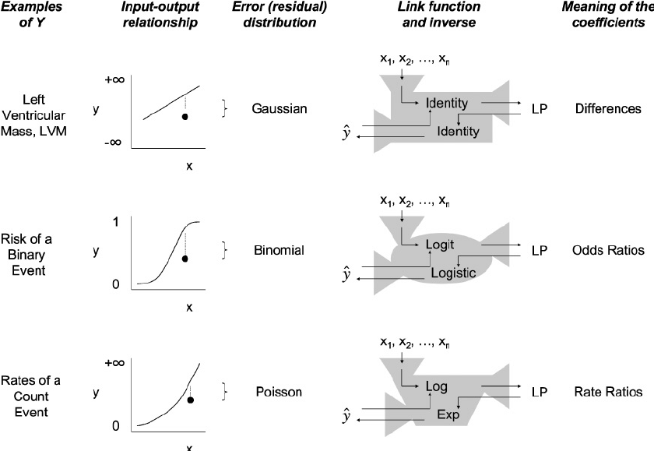
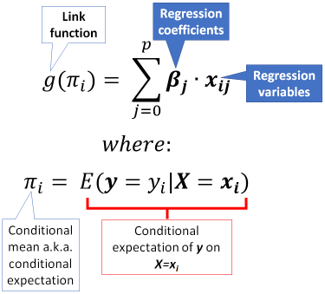
2. Statistical Models
2. Various statistical models
2) Generalized Linear Model

Slide 43
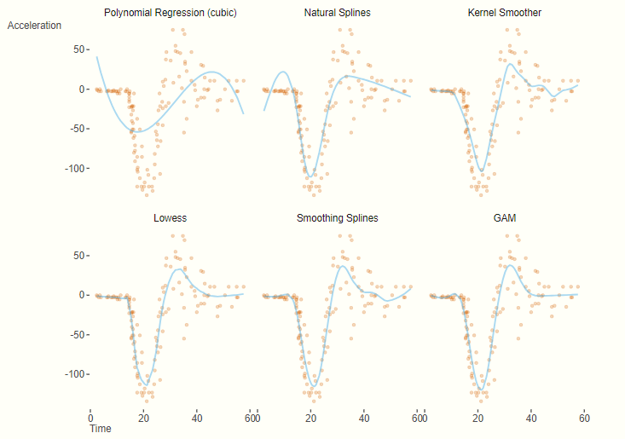
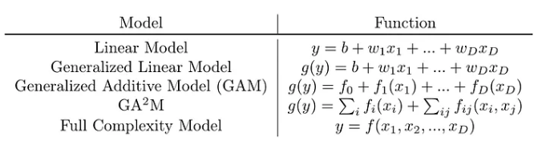
2. Statistical Models
2. Various statistical models
3) Generalized Additive Model

Slide 44
03
Statistical Machine Learning
Algorithms

Slide 45
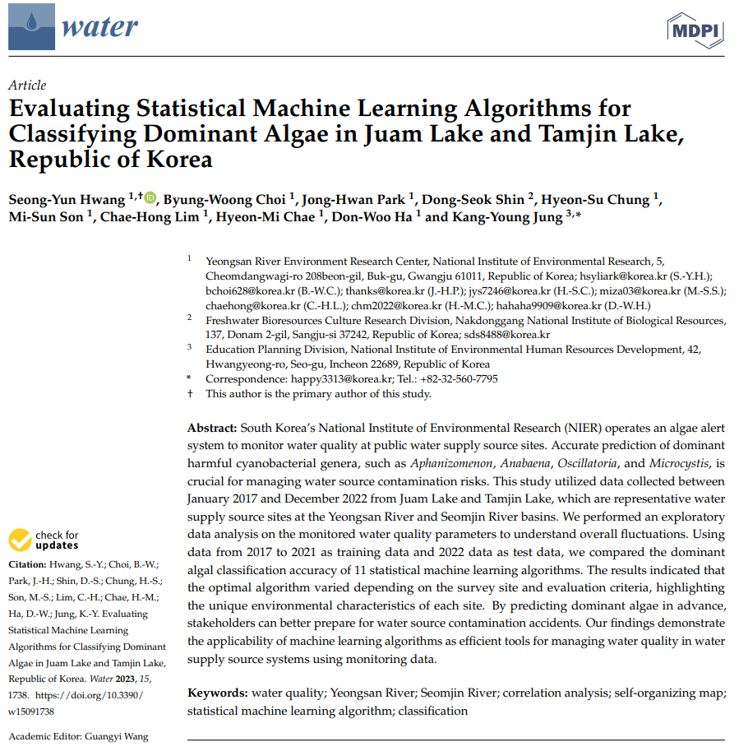
3. Statistical Machine Learning Algorithms
Evaluating Statistical Machine Learning Algorithms for Classifying Dominant Algae in Juam Lake and Tamjin Lake, Republic of Korea

Slide 46
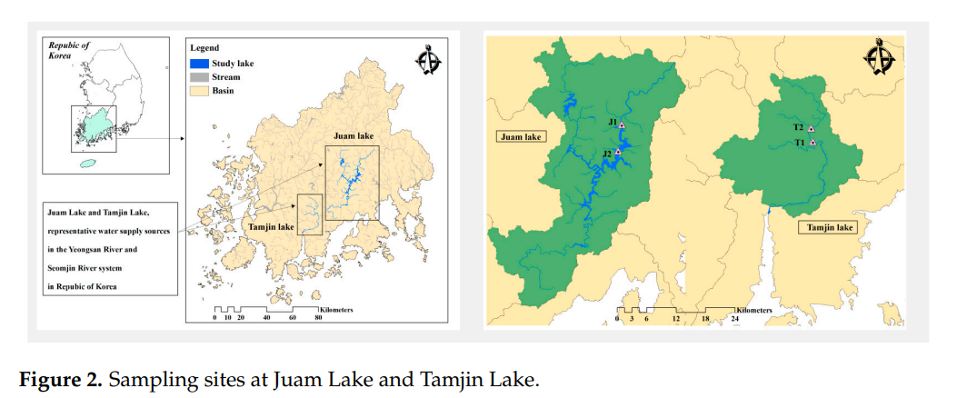
3. Statistical Machine Learning Algorithms
Evaluating Statistical Machine Learning Algorithms for Classifying Dominant Algae in Juam Lake and Tamjin Lake, Republic of Korea

Slide 47
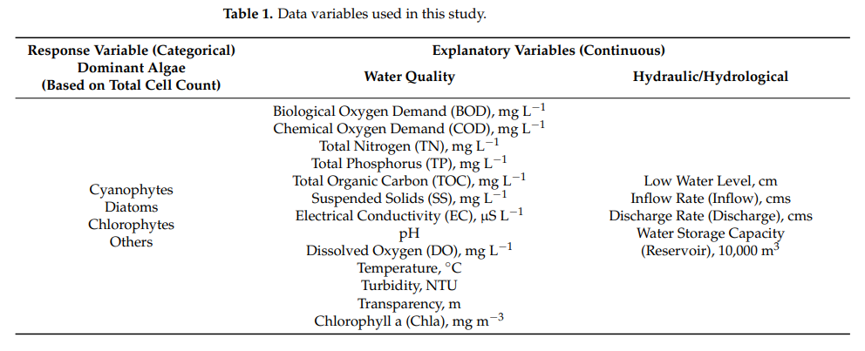
3. Statistical Machine Learning Algorithms
Evaluating Statistical Machine Learning Algorithms for Classifying Dominant Algae in Juam Lake and Tamjin Lake, Republic of Korea

Slide 48
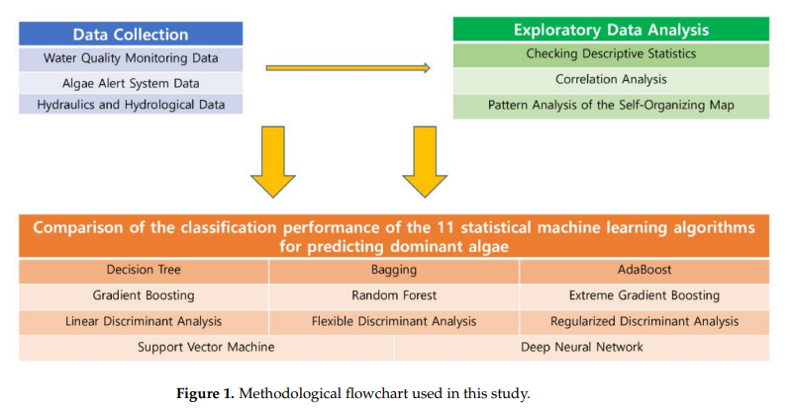
3. Statistical Machine Learning Algorithms
Evaluating Statistical Machine Learning Algorithms for Classifying Dominant Algae in Juam Lake and Tamjin Lake, Republic of Korea

Slide 49
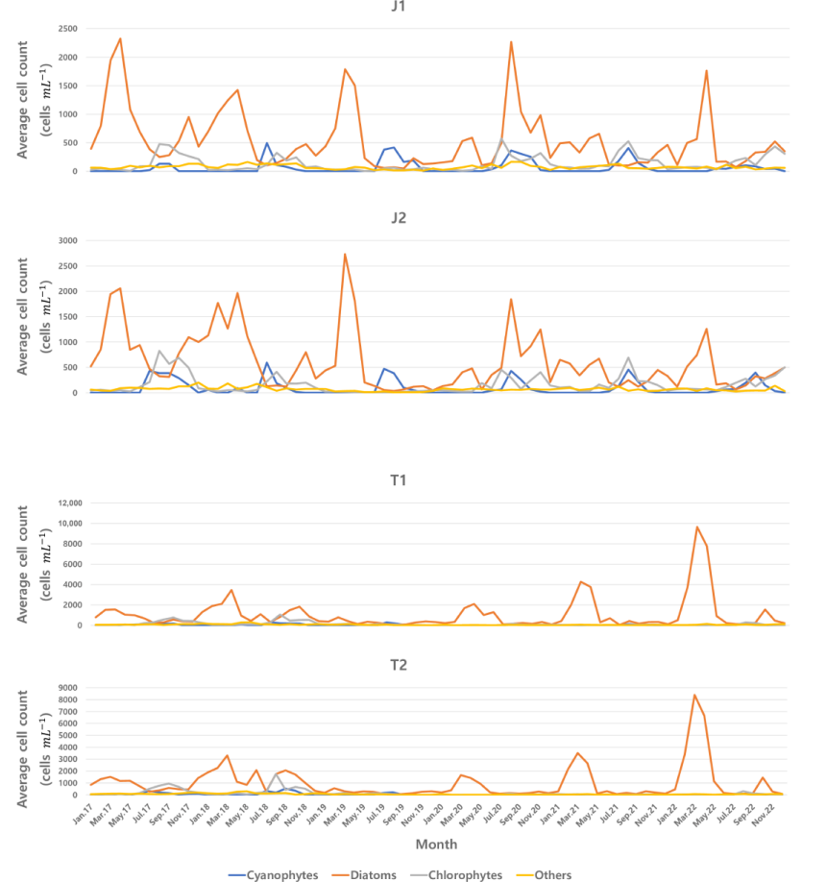
3. Statistical Machine Learning Algorithms
Evaluating Statistical Machine Learning Algorithms for Classifying Dominant Algae in Juam Lake and Tamjin Lake, Republic of Korea

Slide 50
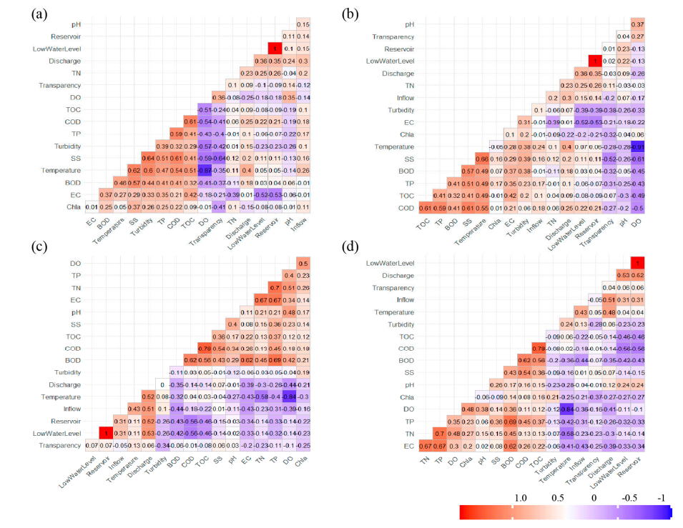

3. Statistical Machine Learning Algorithms
Evaluating Statistical Machine Learning Algorithms for Classifying Dominant Algae in Juam Lake and Tamjin Lake, Republic of Korea

Slide 51

3. Statistical Machine Learning Algorithms
Evaluating Statistical Machine Learning Algorithms for Classifying Dominant Algae in Juam Lake and Tamjin Lake, Republic of Korea

Slide 52

3. Statistical Machine Learning Algorithms
Evaluating Statistical Machine Learning Algorithms for Classifying Dominant Algae in Juam Lake and Tamjin Lake, Republic of Korea

Slide 53

3. Statistical Machine Learning Algorithms
Evaluating Statistical Machine Learning Algorithms for Classifying Dominant Algae in Juam Lake and Tamjin Lake, Republic of Korea

Slide 54

3. Statistical Machine Learning Algorithms
Evaluating Statistical Machine Learning Algorithms for Classifying Dominant Algae in Juam Lake and Tamjin Lake, Republic of Korea

Slide 55

3. Statistical Machine Learning Algorithms
Evaluating Statistical Machine Learning Algorithms for Classifying Dominant Algae in Juam Lake and Tamjin Lake, Republic of Korea

Slide 56

3. Statistical Machine Learning Algorithms
2. Research on the Development and Application of a Deep Learning Model for Effective Management and Response to Harmful Algal Blooms

Slide 57


3. Statistical Machine Learning Algorithms
2. Research on the Development and Application of a Deep Learning Model for Effective Management and Response to Harmful Algal Blooms

Slide 58


3. Statistical Machine Learning Algorithms
2. Research on the Development and Application of a Deep Learning Model for Effective Management and Response to Harmful Algal Blooms

Slide 59

3. Statistical Machine Learning Algorithms
2. Research on the Development and Application of a Deep Learning Model for Effective Management and Response to Harmful Algal Blooms

Slide 60

3. Statistical Machine Learning Algorithms
2. Research on the Development and Application of a Deep Learning Model for Effective Management and Response to Harmful Algal Blooms

Slide 61


3. Statistical Machine Learning Algorithms
2. Research on the Development and Application of a Deep Learning Model for Effective Management and Response to Harmful Algal Blooms

Slide 62

3. Statistical Machine Learning Algorithms
2. Research on the Development and Application of a Deep Learning Model for Effective Management and Response to Harmful Algal Blooms

Slide 63


3. Statistical Machine Learning Algorithms
3. Various Machine Learning Algorithms
1) Decision Tree

Slide 64


3. Statistical Machine Learning Algorithms
3. Various Machine Learning Algorithms
2) Bagging and Random Forest

Slide 65


3. Statistical Machine Learning Algorithms
3. Various Machine Learning Algorithms
3) AdaBoost and Gradient Boosting

Slide 66


3. Statistical Machine Learning Algorithms
3. Various Machine Learning Algorithms
4) Discriminant Analysis

Slide 67


3. Statistical Machine Learning Algorithms
3. Various Machine Learning Algorithms
5) Support Vector Machine

Slide 68


3. Statistical Machine Learning Algorithms
3. Various Machine Learning Algorithms
6) Deep Neural Network

Slide 69


3. Statistical Machine Learning Algorithms
3. Various Machine Learning Algorithms
7) Convolutional Neural Network

Slide 70
감사합니다

